Slide 1
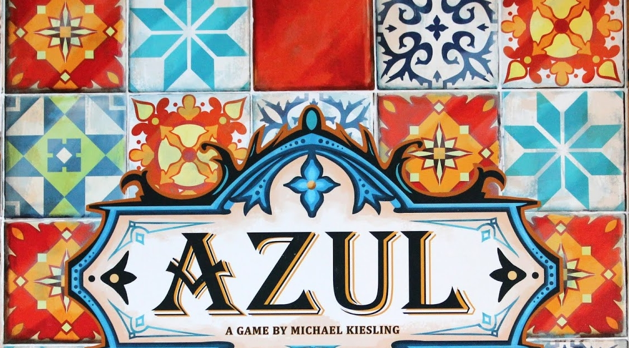

Azul Board Game Agent Presentation
COMP90054 AI PLANNING FOR AUTONOMY, Group Project 1, Semester 1 2020
Student members: Albert Tien
Jiawei Liao
Yachao Ren
Team name: 404Error
Notes:
Hi, this is team 404 error, in this video we will be presenting our developed AI agent to play

Slide 2
Introduction: Creating an Azul board game agent
Naïve Agent
Breadth First Search Agent (BFS)
Minimax Agent
4. Monte Carlo Tree Search Agent (MCTS)
Notes:
We have developed agents using 4 different technique, those technique being naïve agent, breadth first search, minimax and monte carlo tree search, The minimax agent was the best we developed.

Slide 3
Agent Design: Naïve agent
Start with Naïve Agent :
Rank Metric A (num to pattern line , num to floor line) &
Rank Metric B (end game score) &
Rank Metric C (count neighbor tiles)
Created 3 version
Best version has 67% win-rate against default naïve_player
Notes:
Naïve agent is “naïve” because It only ranks moves in the current turn without any future predictions or care of opponent.
We have created 3 different versions
Our best version uses 3 metrics to rank the moves and it could beat the default naïve player with a 67 pa winrate
Ranking number to pattern line, and tie breaker. Then we add ranking of neighbor

Slide 4
Agent Design: Breadth First Search Agent (BFS)
Breadth First Search Agent :
Rank Metric A (num to pattern line - num to floor line) &
Prune moves number = 10 &
Rank Metric B (turn score+ end game score) &
Prune moves number = 10 &
Tie Break BFS using Metric B (turn score+ end game score)
Created 2 version
Best version has 54% win-rate against best naïve agent
Notes:
After experimenting with naïve agent we switched to Breadth first search agent, We used the similar metric as naïve agent but used breadth first search to explore the moves in the next two turns. the number of moves searched were prune due to time limits. We have created 2 different versions​ but Our best BFS agent only performs marginally better than our best naïve agent

Slide 5
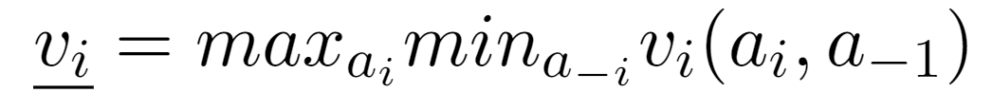
Agent Design: Minimax
“Minimax is a technique that combines search algorithms and game theory and is commonly used in two-player zero-sum games.”
Notes:
(After all, we move on to the Minimax techniques.)
Minimax is a technique that combines search algorithms and game theory and is commonly used in two-player zero-sum games)
You can see the formula given by max times min for each depth

Slide 6
Agent Design: How it works ? Minimax Agent
Step 1: Sort moves using 3 metrics
Max: me
depth 1
4
3
4
Min: Opponent(op)
depth 2
3
5
3
5
3
5
Max: me
depth 3
9
7
9
5
4
2
5
4
2
5
4
2
Max: me
depth 1
4
4
3
Min: Opponent(op)
depth 2
3
5
3
5
3
5
Max: me
depth 3
9
5
4
2
7
5
4
2
9
5
4
2
Notes:
We limited the minimax search depth to only 3 and prune the moves to size 9 using the ranking method defined earlier to satisfy the time constraint.

Slide 7

Agent Design: How it works Minimax Agent
Step 3:depth first search to find score difference when reached depth 3
Max: me
depth 1
4
4
Min: Opponent(op)
depth 2
3
5
3
5
Max: me
depth 3
9
7
5
4
2
5
4
2
9-3=5
5-3=2
4-5=-1
2-5=-3
7-3=4
5-3=2
4-5=-1
2-5=-3
Notes:
The search ends when it reaches the third layer or the end of round and calculate the score difference between our player and our opponent.

Slide 8
Agent Design: How it works Minimax Agent
Step 3:depth first search to find score difference (depth 3 – depth 2) when reached depth 3
Max: me ​
depth 1
9
9-3=5
7
7-3=4
return
4
return
4
Min: Opponent(op)
depth 2
Max: me
depth 1
3
5
3
5
Max: me
depth 3
9
7
5
4
2
5
4
2
9-3=5
7-3=4
Notes:
At each opponent layer we minimise the score difference and maximise the score difference at each player layer.

Slide 9

Agent Design: How it works Minimax Agent
Step 3: pick move (depth 1) with best score difference from (depth 3 – depth 2)
9
7
Max: me
depth 1
Best move
4
4
Min: Opponent(op)
depth 2
3
5
3
5
Max: me
depth 3
9
7
5
4
2
5
4
2
Notes:
The action executed is the action that maximises the score difference at the top player layer

Slide 10
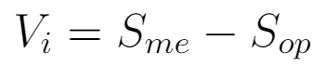
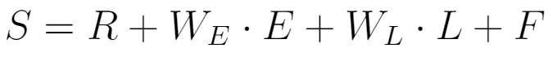
Agent Design: An overview of Metrics and Methods used Minimax Agent
Where:
R: the round score
E: the end of game bonus
L: the number of non-emptied pattern lines
F: the first player token
Notes:
V is defined by the heuristic score difference between our player’s and its opponent.
We defined the score of one player using a combination of round score, end game score bonus , number of non-epmtiy pattern lines and the availability of first player token.
We assigned associated weights and fine tuned them for better performance.
R stands for round score and E stands for end of game bonus, and assigned associated weight to
Metric1: tiles will be distributed in top 3 rows, given they are easy to complete and require least total amount of tiles = more score least with tiles used
a few tiles in 4,5 row to complete column to ear on the bonus column score
Metric 2 = Pick moves that result in higher score,
if the depth is big, means chance of reaching that move is lower so less important
Will push tiles to larger pattern line if possible,
this maximize tile space available
Will prevent penalty to not having space to put tiles in current round
Metric 3 = Make sure the least line to be empty at the end of the round.
To save more space in pattern line
since give more choice for next round
take a small penalty hit to prevent big penalty hit in next round,

Slide 11
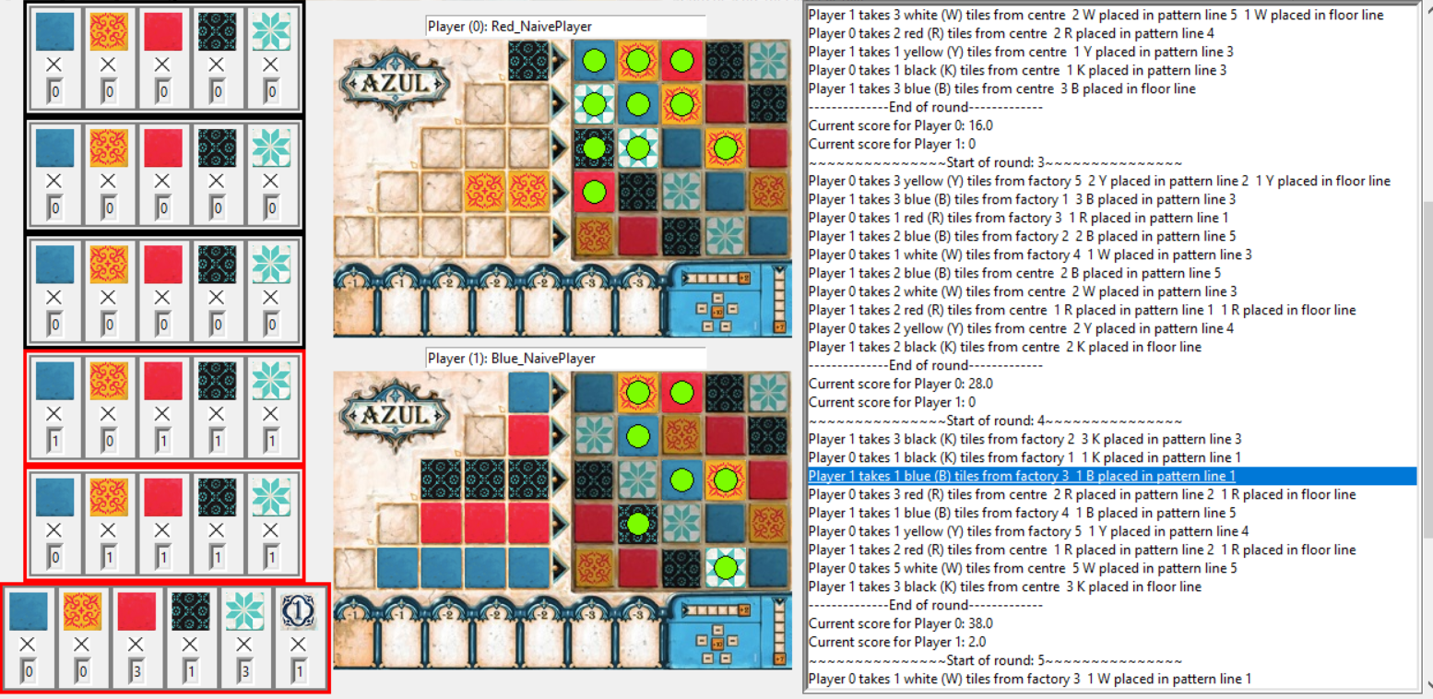
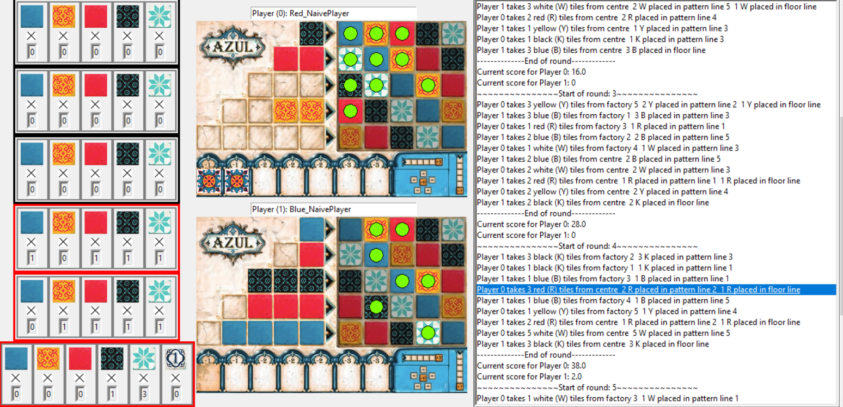
Agent Design: Minimax Agent vs Naïve Agent Demo Showcasing metrics and methods used during different scenario
Self
Self
3 Red = line 2 or 3?
Line 2 better :
Penalty = yes = bad
Connectivity = yes =good, higher score)
Firsthand token = yes = good, safer
Lines stay empty = yes = good, lower risk of penalty next turn
Opponent: naïve agent
Opponent : naïve agent
Score: minimax 61 : 8 naïve
Notes:
(Cursor point to left purple tile, 3 red can be pick)
We will now show case our minimax agent versing our best naïve agent
As seen in the example shown, 3 reds can be selected by the minimax agent, in either line 2 or 3
A new player like my self will pick line 3, because it fits perfectly and has no penalty
However, our minimax agent picked line 2, because of 3 things, firstly , it received firsthand token, secondly, it give better score, even with the penalty included, thirdly, line stays empty at the round end.

Slide 12
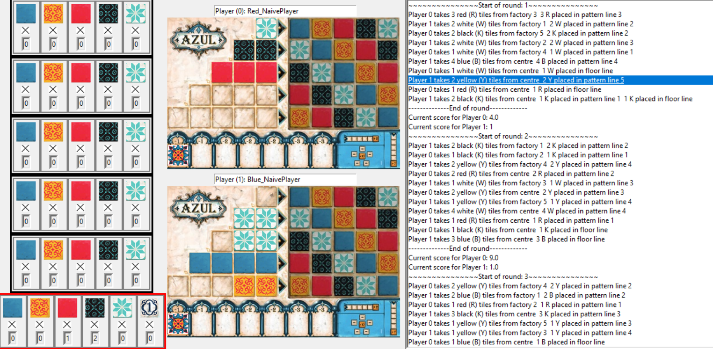
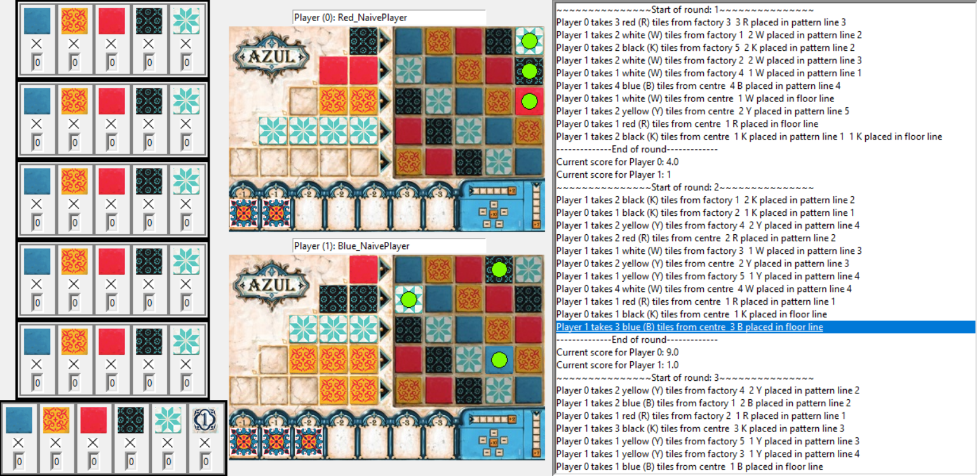
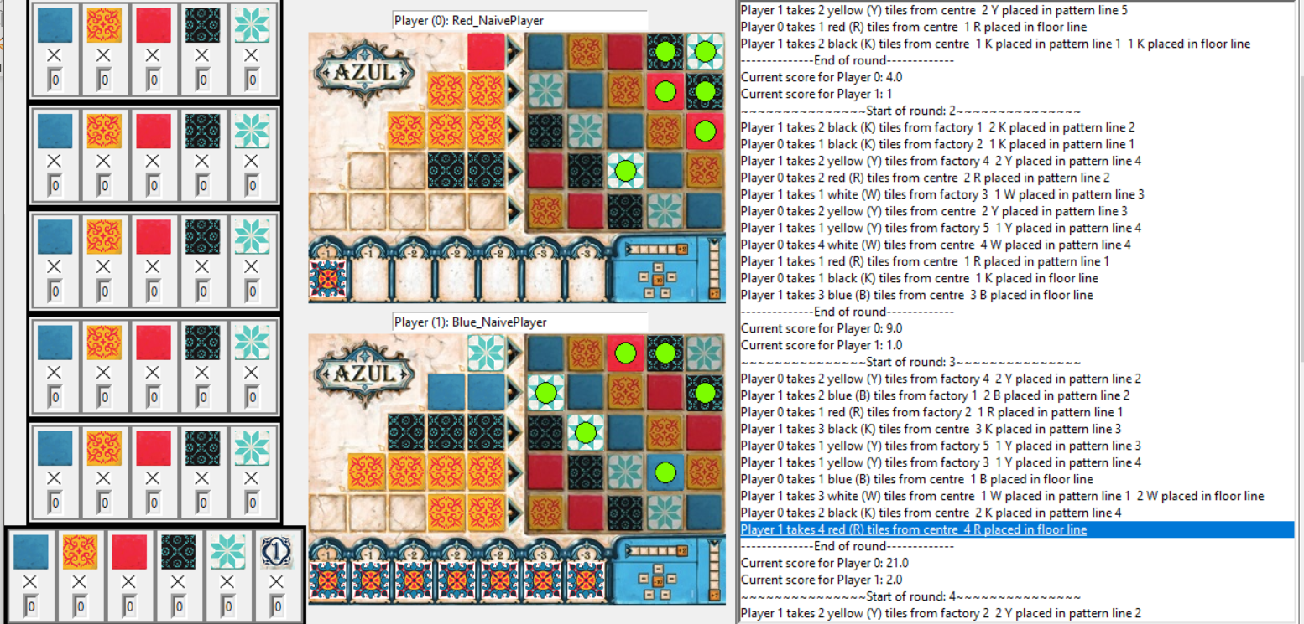
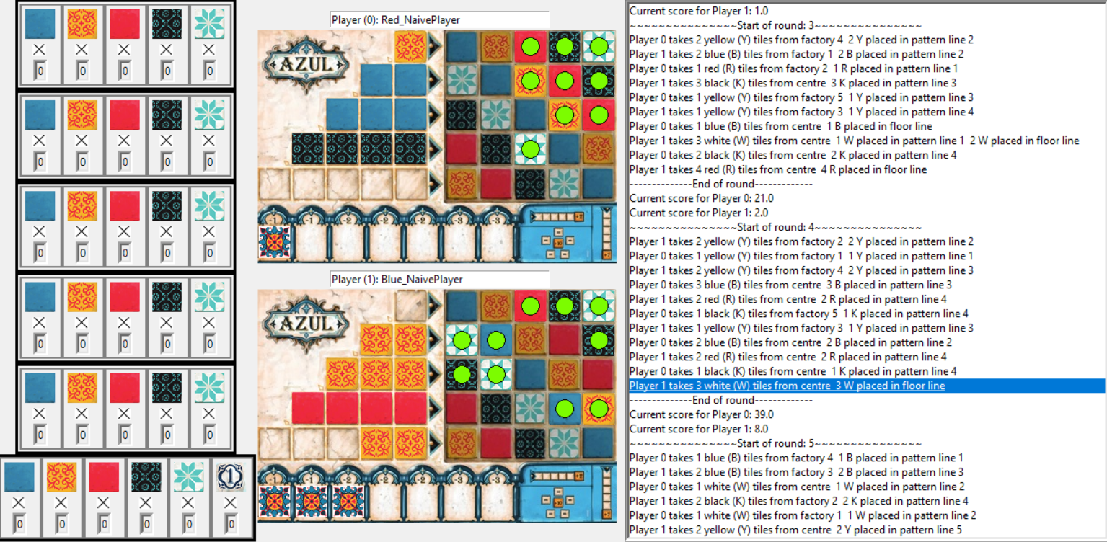
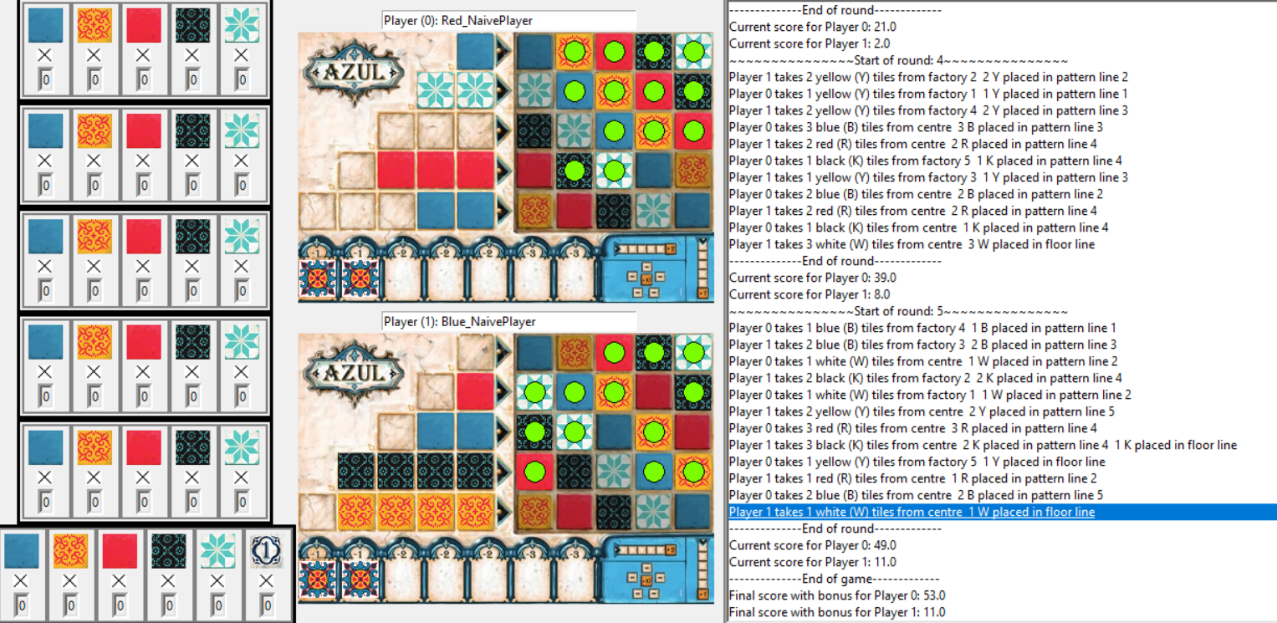
Agent Design: Minimax Agent vs Naïve Agent Demo Showcasing different scenario
Naïve agent vs minimax agent:
round 1: 2 yellow to line 5
round 2: no attempts to fill line 5
round 3: no attempts to fill line 5
round 4: no attempts to fill line 5
round 5: fail attempt to fill line 5
Why: no metric to address fill in none empty line
Effect: increase in penalty, round 3
Score: 53 vs 1
Naive agent: Round 1, 3rd last turn
Naive agent: Round 2, last turn
Naive agent: Round 3, last turn
Naive agent: Round 4, last turn
Naive agent: Round 5, last turn
Notes:
Naïve agent vs minimax agent:
We will now show another case our best naïve agent agent versing our best minimax agent, where our naive agent sadly lost 1 to 53
As seen in the example shown
In round 1, our naïve agent
pushed 2 yellow tiles to line 5,
for the next 4 rounds, line 5 was never cleared,
because it didn’t give enough score to be considered.
This leads to penalty in round 3 since line 5 could not accommodate more tiles from the center pool
This phenomena is due to the naïve agent not using a metric that considers emptying lines

Slide 13
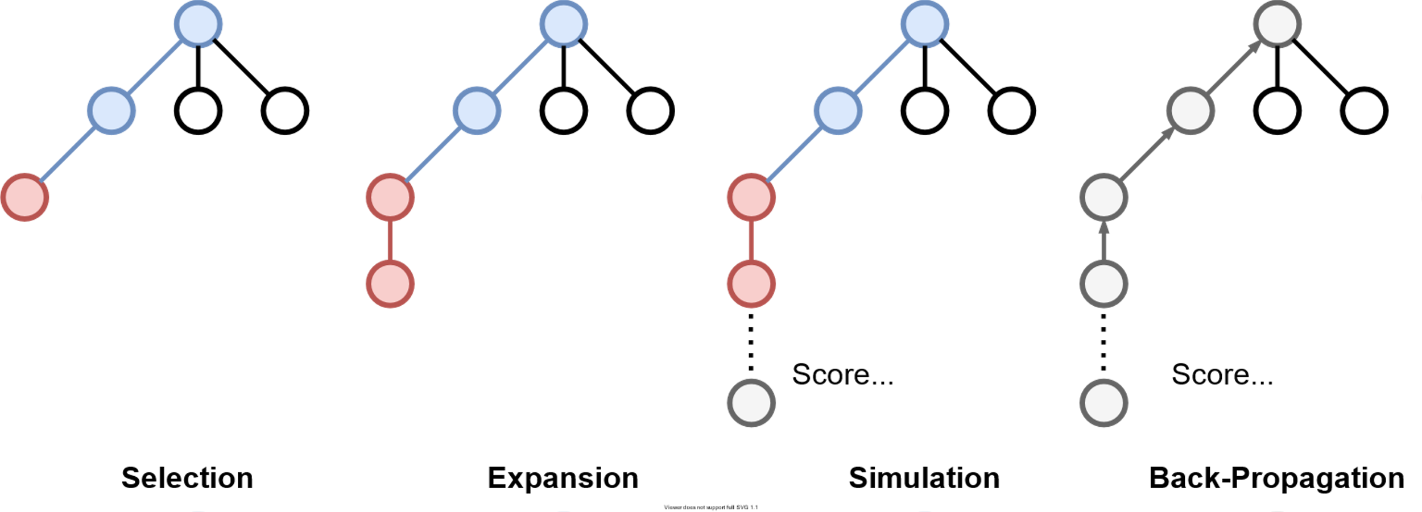
Monte Carlo Tree Search flowchart
Agent Design:​ Monte Carlo Tree Search
Notes:
Monte Carlo Tree Search (MCTS) is a popular heuristic search algorithm for games.
A general MCTS search iteration comprises of four steps:
First Selection: Start from Root node and select one of children that has not been simulated ,using a selection policy.
Secondly, Expansion: Select an unexecuted action of the selected node to execute and expand its child game-state node
Thirdly Simulation: Simulate from the expanded node till the end of round using a roll-out policy and computes the reward.
Lastly Back Propagation: Back propagate the rewards to its ancestors recursively.

Slide 14
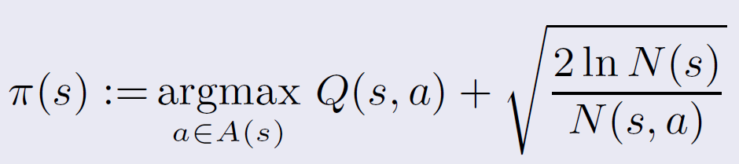
Selection Policy: UCB1
Q = sum of score of all children/number of visits
Score = S_me – S_op,
where S = Round score + W_E*End_game_score_bonus+ W_L*non_emptied tiles at round end
W_E = 1
W_L = -4
Notes:
We used the UCB1 policy as our selection policy. where
Q is defined by the average score of its children
We used a similar Score function from minimax modified the weighting because mcts simulates till the end of round instead of just the next three turns.

Slide 15
Roll-out policy for Simulation
Random Policy: Randomly choose the next move
Naïve Policy: Choose the move with the highest number of tiles placed in a pattern line, and break ties using lowest number of tiles placed in floor.... and maybe more
Notes:
We considered two roll-out policies for the simulation.
The first one is completely random.
The second one is an application of a naïve agent.

Slide 16
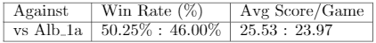
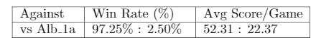
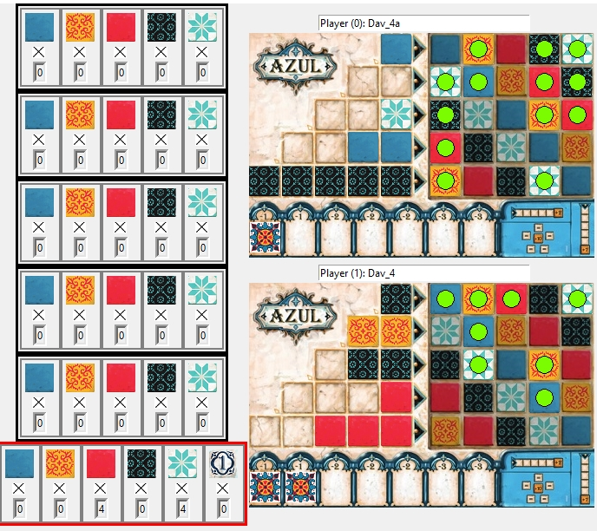
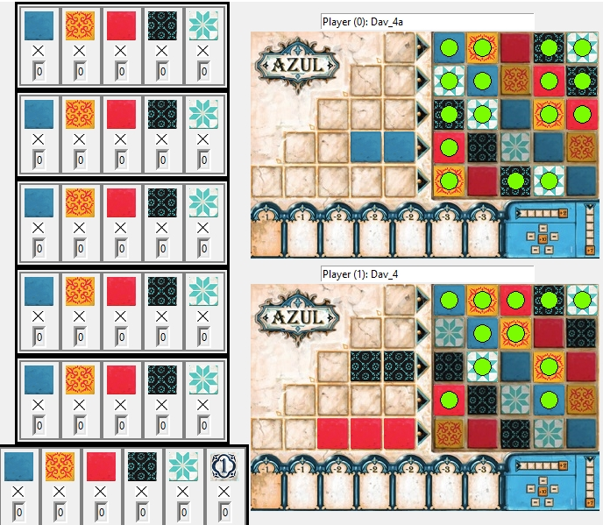
Random rollout vs naïve rollout
Random rollout produces very low-quality value for Q
Random rollout vs naïve =
Naïve rollout MCTS vs naïve =
Roll out: naïve
Roll out: naïve
Rollout agent:
Random vs Naïve
1: 39
Roll out: random move
Roll out: random move
Notes:
With other parameters equal, the different rollout agent caused a drastic performance difference.
Where the random rollout agent scores merely 50/50 against our best naïve agent, the naïve rollout agent completely dominated it by 97% win-rate.
It can be seen in the bottom that the agent using random move does unnecessary floor tiling and attempts to finish the game
At a losing score. While the naïve rollout forms a very nice pattern on its grid.

Slide 17
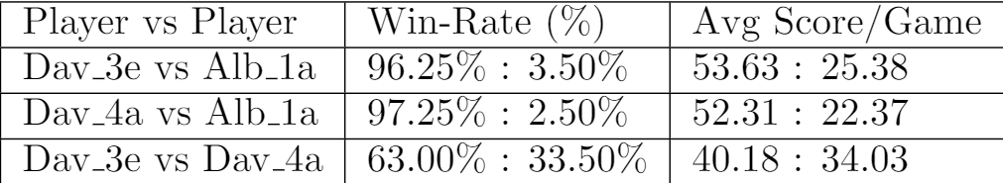
MCTS vs Minimax: Why our minimax is stronger
Quality of roll-out matters!
Notes:
We decided to choose our best minimax agent Dav_3e to participate in
The final tournament. It could beat our best Minimax agent Dav_4a in
A dual and has also scored high finishes in the practice tournament.
Minimax agents tend to be conservative in play but we did not have enough time to
Improve our MCTS agent's rollout to desired levels.

Slide 18
Strength and Weakness: Insights on the “good” and the “bad “of development and utilization of the four technique
Technique: | Strength | Weakness
Naïve Agents | Short turn time, can be used in MCTS for roll out fast testing over 1000 runs to see what metric perform well. | Single depth only low win rates
Breadth First Search agent | Allows looking at move in future turns | Cannot go through very deep depth in a short period requires move prune to prevent timeout
Minimax agent | Stable performance against all levels of opponents | Could not exploit weak opponents due to conservative strategy
Monte Carlo Tree search | Saves a game tree so can check info Doesn’t reply on as much human understanding of the game | Need more time on developments more metrics require tuning Requires move cut to prevent timeout
Notes:
Here is our strength and weakness of our four agents.
Naïve agents have low win rate low win-rates but very fast to run and could be used for testing metric and a mcts rollout policy.
BFS need more prune to prevent timeout, and MCTS still needs more time on developments.
At the moments, although Minimax have draw back for being conservative in play
Minimax agent is our finally choice since it has a stable performance against all levels of opponents.

Slide 19
Challenges: Difficulties we encountered:
Time limit of 1 second to select move per turn:
limits potential of certain techniques
forces fine tuning to increase win rate like “squeezing the toothpaste”
Covid-19:
Limits communication methods, e.g. no face to face
Reduces group meeting frequency
Notes:
Time limit per turn was a big challenge to over come, eventually we used pruning of moves and limit of search depth to mitigate.
Covid-19 prevented us from meeting face to face and reduced teamwork efficiency

Slide 20
Improvement: What we would do if we were given more time
Minimax agents:
create a game tree to save moves already process for next turn
MCTS agents:
utilize start round5 seconds wait better
use a better roll out agent
fine tune selection policy’s parameters
Notes:
Our minimax agent and MCTS agent still has room for improvements
The minimax agent could utilize a game tree that saves moves processed and this tree can be referenced in future turns.
The MCTS agent could improve by using a better roll out agent that is fast and has high win rate, it can also improve if we better utilize the 5 seconds provided at the start of each round or if we fine tune selection policy’s parameter further.

Slide 21
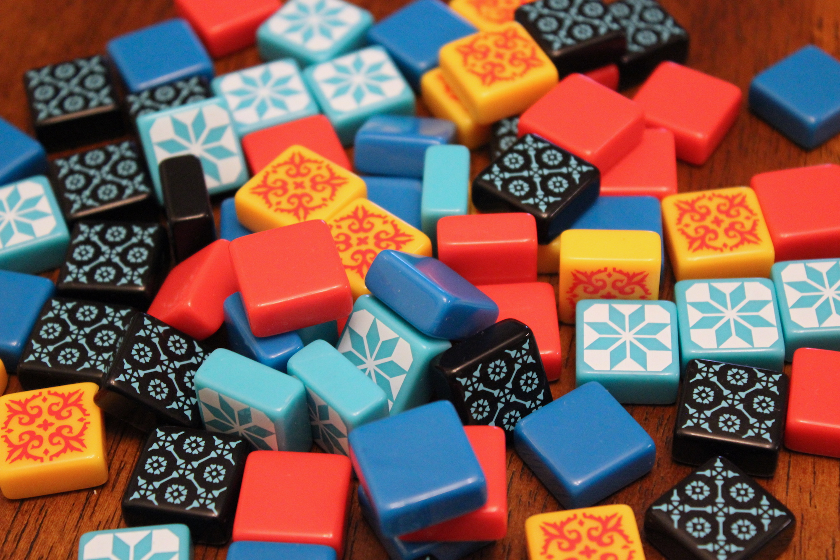
Thank you!
Albert Tien
Jiawei Liao
Yachao Ren

Slide 22
Agent Design: Timeline Overview Naïve Agent & Breadth First Search Agent (BFS)
Start with Naïve Agent :
Rank & Tie Break: Rank Metric A (num to pattern line) &
Tie Break Metrics B (num to floor line)
Combine: Rank Metric A (num to pattern line) + Rank Metric B (num to floor line) =
Rank Metrics AB (num to pattern line - num to floor line)
Add: Rank Metric C (turn score + endgame score)
Add: Rank Metric D (count neighbor tiles)
Change: Rank Metric C (turn score + end game score) -> Rank Metric C (end game score)
Final: Rank Metrics AB (num to pattern line - num to floor line) &
Rank Metric C (end game score) &
Rank Metric D (count neighbor tiles)
Notes:
Naïve agent is “naïve” because It only ranks moves in the current turn.
The timeline is shown on the slide and the main highlight , in blue, shows the final methods we used for naïve agent.

Slide 23
Agent Design: Timeline Overview (continue) Naïve Agent (SD) & Breadth First Search Agent (BFS)
Switch to Breadth First Search Agent :
Rank & Tie break : Rank Metric C (turn score+ end game score) for depth 1 &
Tie Break BFS using Metric C (turn score+ end game score) for depth 2 and 3
Prune : Prune moves number = 10
Add: Rank Metric AB (num to pattern line - num to floor line)
Final: Rank Metric AB (num to pattern line - num to floor line) &
Prune moves number = 10 &
Rank Metric C (turn score+ end game score) &
Prune moves number = 10 &
Tie Break BFS using Metric C (turn score+ end game score)

Slide 24
Agent Design: How it works Minimax Agent
Step 2:Prune number of moves to 9
Max: me
depth 1
4
4
3
Min: Opponent(op)
depth 2
3
5
3
5
3
5
Max: me
depth 3
9
7
9
5
4
2
5
4
2
5
4
2

Slide 25
Insights: Winning tips for minimax agent: Techniques used to maximize ranking in competition
Insights:
Cut moves due to timeout
Need score metrics+ other metrics to better rank(sort) moves and cut move list
Need a combination of metrics for output a final combined score for each move
Need to minimize opponent score and max self score
Will treat opponent as a smart agent, so is very careful
Implementation of insights:
Sort move using metric a, b, c,……
Minimax 3 depth
Tie breaker in sort using 5+ useful metric
Cut moves to 9-10, after every sort and turn simulation
Utilize 5 sec during start round: calculate best move with increased num of move 14
turn score + weight*depth*end game score – weight*number of none empty line + firsthand token
Notes:
Picking Up
Ball Spawn Randomly

